Slide 1
To minimize the necessity of making any updates in the initial code, a Common Config file was created. You don’t need to add it to already existing LPs with the forms, but only to new ones, starting from the time, when you will update a common config file once during the process of deploying the tool to new divisions / SMP segments. In that file you will find: 1) existingDivisions (used in the tool for routing to templates, filling up the division1 field, etc) 2) leadGenTypesExisting (properties, existing in Division fields configuration templates) 3) mqlFormTypes (if form type is not in the list, a non-mql form type will be loaded) 4) countries
5) smpRouting (place links to new Division fields configuration templates here)
6) nonSMP_baseTemplate (link to non-smp template)
7) langRouting (place links to Language configuration templates here)
8) mqlFormTypes (used in routing, to mql templates or not)
9) additionalFieldsConfig (this functionality was a plan for future (adding ON24 fields, etc)
10) scriptsAndModules3M (Global form script, other 3M scripts and modules currently used in 3M. They are loading after the form has been generated) loadModule1 – is a link to 3M module, scripts3M – list of scripts to be loaded)
restModules – list of other 3M modules
restScripts, - you can add new scripts here, if needed (Array of strings) (All they will be loaded AFTER the form has been generated)
How to use (just place the script right above the FormComponent js file on LP, like below:
You may notice a ?ver=2 at the end. It’s for solving a problem with caсhing (like you did previously). Here can be ?version= or ?v= , it doesn’t matter.

Slide 2

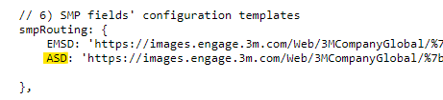
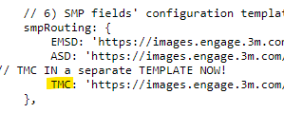

:
How to add new Divisions or SMP segments to a FormComponent tool.
Case 1: We need to add new Division
Common Config file: https://images.engage.3m.com/Web/3MCompanyGlobal/%7b74b63b20-014d-49b3-b044-71789f42f8d9%7d_FC_commonConfig.js
In Common Config file: 1) Please check In list item 1 (‘existingDivisions’) if your Division exists in the list with relevant data.
Please be aware of one specifics: cropped value in ‘existingDivisions’ (highlighted with yellow):
must be matching with the key in ‘smpRouting’ (list item 6):
As you see, that so as TMC is a part of ASD currently, it’s reflected as it is (screenshot above). However, when TMC will become a separate division, both places should be changed to relevant short name (new TMC template to be added on the right side):

Slide 3


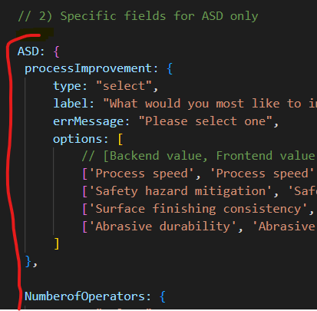
2) Please check In list item 2 (‘leadGenTypesExisting’) if your short Division name is there and all relevant types for the particular division are listed in the Array. Default values for all divisional fields configuration templates are: ‘CA’ and ‘Basic’. If you have something specifics, for example nested SMP segment inside the division’s template (like TMC in ASD), please reflect them accordingly:
3) Please prepare Division’s fields configuration template for the new Division and place a link into the list item 6 (‘smpRouting’) (In example below, TMC is like a separate division)
4) Place all the data about your custom fields into the language templates like a new property with a key, relevant to a short division name and value as object with data:

Slide 4
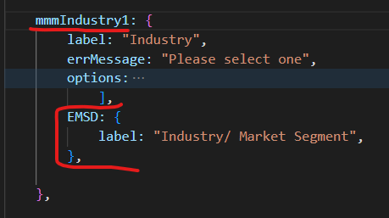
5) If you need to add an alternative translation to already existing (for all divisions) standard field, use a nested Object with key matching to a short division’s name, like below:
If your form for new created division is not being generated – in most cases it’s because it can’t find data for new specific for this division fields. Please check language template, if all is there correctly. Other reason can be because of caсhing (will be fixed itself after some time).

Slide 5

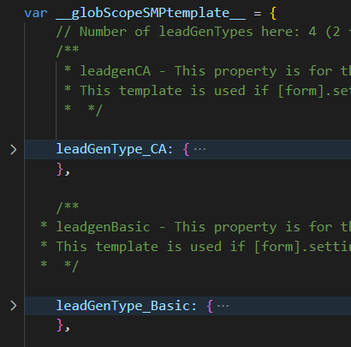
Case 2: We need to add new SMP Segment (Part of existing Division)
1) In case if form Names always reflect the name of the Division, which your new SMP segment belongs to, just skip this first step (for example, PGF segment is not reflected in form name as PGF, but it is still ASD). Otherwise, please reflect the name of the division In list item 1 (‘existingDivisions’) of the Common Config file. For example, TMC is reflected in form name as TMC, but the configuration of the fields is placed in ASD template:
2) You need to add new property into the Division’s fields configuration template . Default properties in each template are: leadGenType_CA
leadGenType_Basic
So, if I want to add, for example, PGF into the ASD template, I need to create property with key following the naming convention:
“leadGenType_” + “any custom name” For example, for PGF I would create these 2 properties: leadGenType_PGF_CA
leadGenType_PGF_Basic

Slide 6
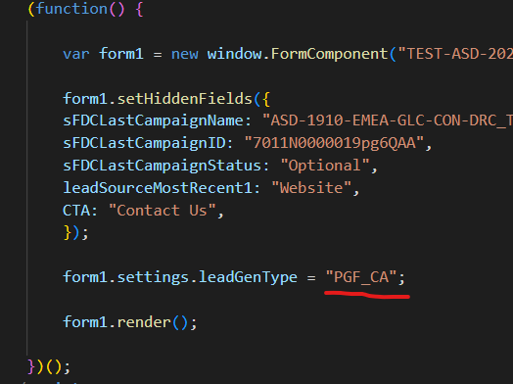

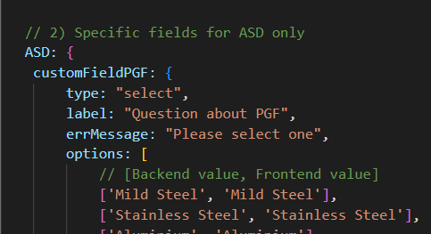
And on LP, if I need to use one of these 2 templates for the particular Division, I will reflect the following: form1.settings.leadGenType = " PGF_CA“
Or: form1.settings.leadGenType = " PGF_Basic“
3) Add these new keys of leadGenType templates into the list item 2 (‘leadGenTypesExisting’) :
4) Place all the data about your custom fields into the language templates. So as your new SMP segment is a part of a particular division, just add data for new custom fields inside the relevant property, key of which should be matching with short name of the division. Example for PGF (part of ASD):

Slide 7
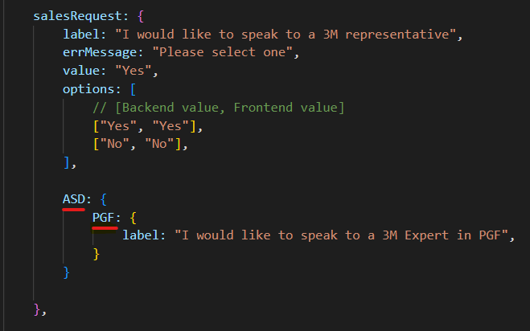
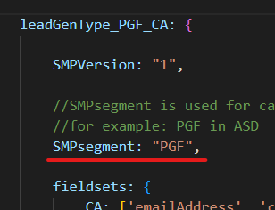
For the standard fields, in case if PGF want to have their own texts, you should reflect this nesting in language template accordingly:
5) Finally, in order to explain to the tool, that you want to take translations from the nested SMP segment (like on previous screenshot). In Division fields configuration template yon need to add SMPsegment equal to value, which you provided in language templates (on previous screenshot it’s PGF), so that is why: SMPsegment: PGF,

Slide 8
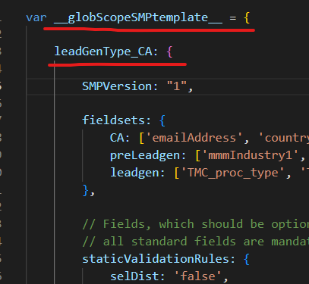
Case 3: We need to take out SMP Segment from the current Division and to make it to be a separate. Example for TMC:
From the ASD fields configuration template take the properties, relevant to TMC exactly (leadGenType_TMC_CA and leadGenType_TMC_Basic) with all the data and place them into a separate configuration file (in Object __globScopeSMPtemplate__). So as in each template we must have standard values first (CA and Basic), please update keys from leadGenType_TMC_CA to leadGenType_CA and leadGenType_TMC_Basic to leadGenType_Basic.
Like below:
However if you need to create more leadGenTypes than 2 into one config file, you can use any names (but ‘CA’ and ‘Basic’ must be always)

Slide 9
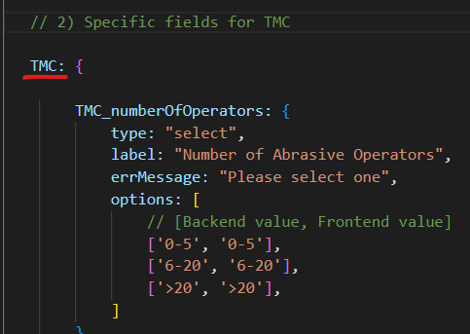
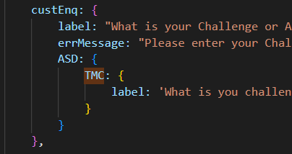
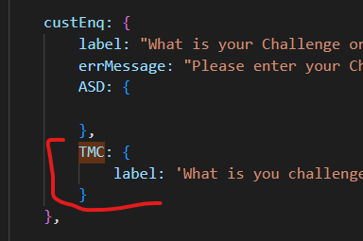
2) Update in list item 1 (‘existingDivisions’):
from:
To:
3) Add link to TMC fields configuration template ‘smpRouting’ (list item 6):
4) Move data of all custom TMC fields in language templates from ASD Object to a TMC one:
And for specific translations please move TMC from ASD like below:
Was:
Became:

Slide 10
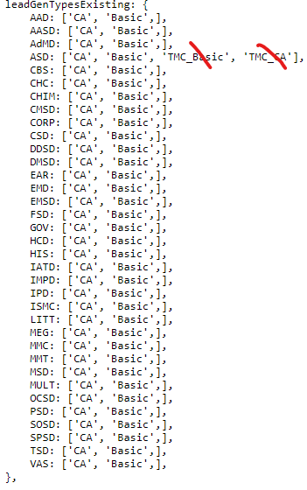
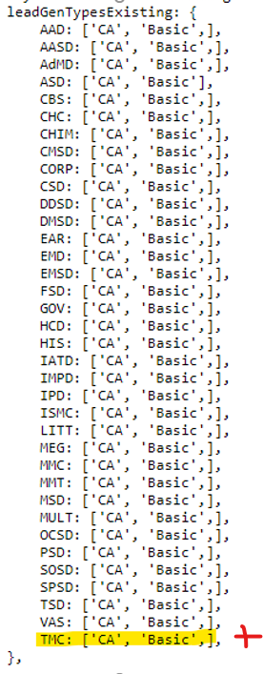
5) Update In list item 2 (‘leadGenTypesExisting’)
From:
To:

Slide 11

5) Please remove from LP:
From: form1.settings.leadGenType = "TMC_CA"; Correct values:
form1.settings.leadGenType = "CA"; (default value for all except SAM forms) or form1.settings.leadGenType = “Basic"; (default value for SAM forms)
6) Please remove SMPsegment property from the Division’s fields config. Template.

